Slide 1

Construal of number in the Ukrainian bahato construction
Laura A. Janda
Yuliia Palii
UiT The Arctic University of Norway
SCLC 2024
November 1­3–15, 2024
Notes:
LAJ

Slide 2
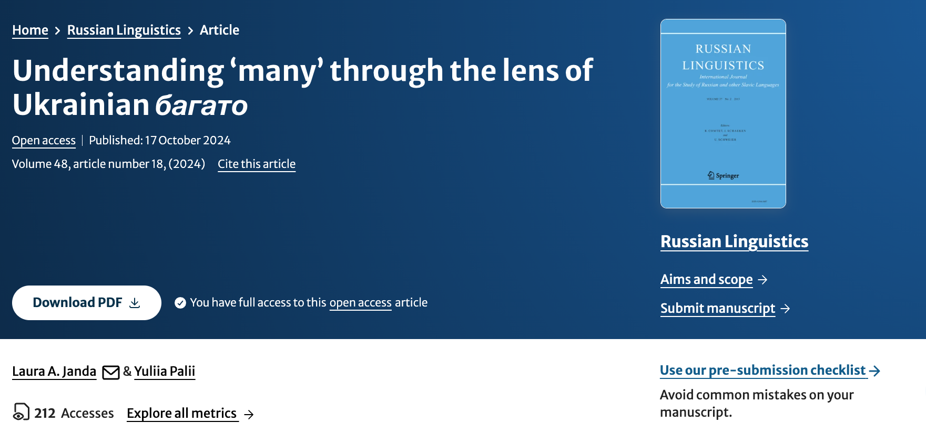
https://link.springer.com/article/10.1007/s11185-024-09301-7

Slide 3


багато людей...
‘many people’
прийшло ‘came’ (SG)
прийшли ‘came’ (PL)
Direction of historical development
Notes:
LAJ

Slide 4
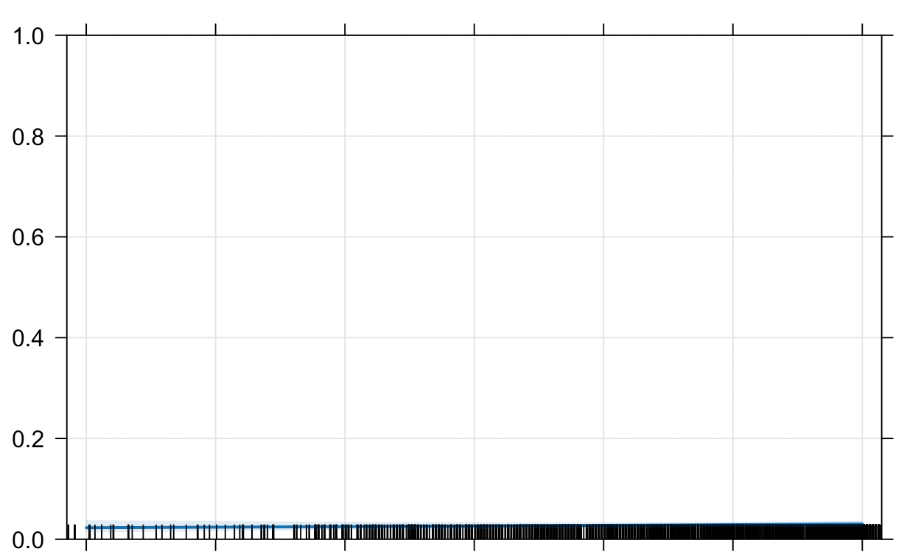
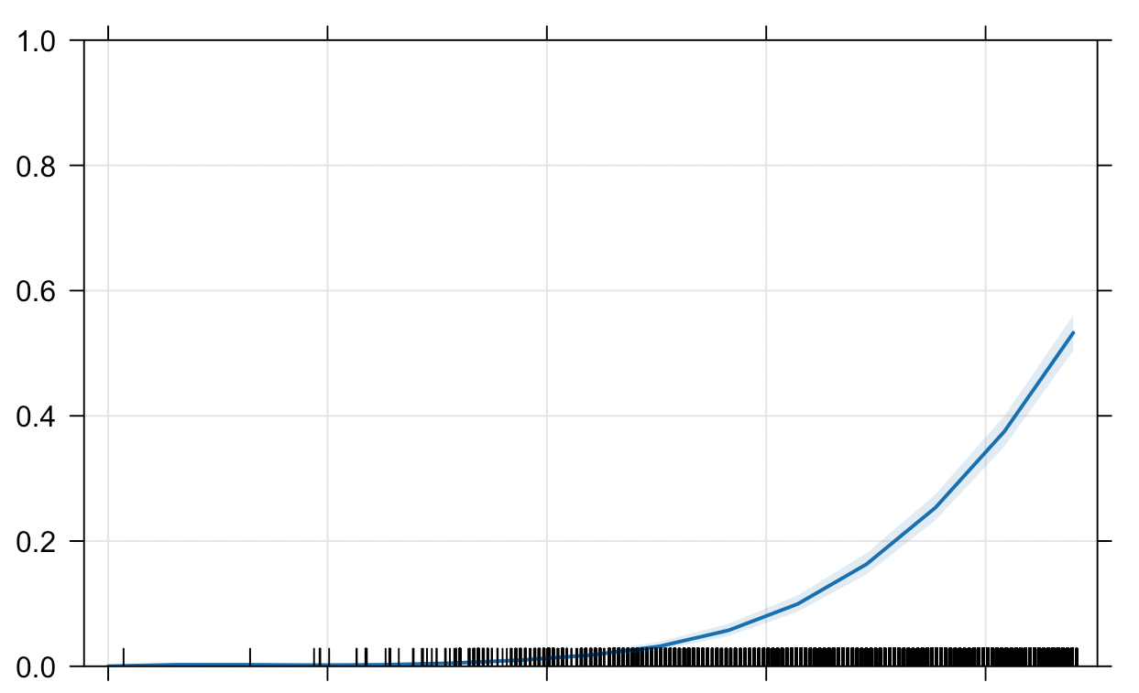
Russian много
Ukrainian багато
Percent PL
Percent PL
1742
2021
1819
2023
Effect plot based on
logistic regression
6 612 observations from Russian National Corpus
Baseline: 94.7% SG verb forms
(other factors: word order, animacy)
Effect plot based on
logistic regression
28 491 observations from GRAC
Baseline: 69.1% SG verb forms
(other factors: word order, animacy, verb lemma)
Notes:
LAJ

Slide 5
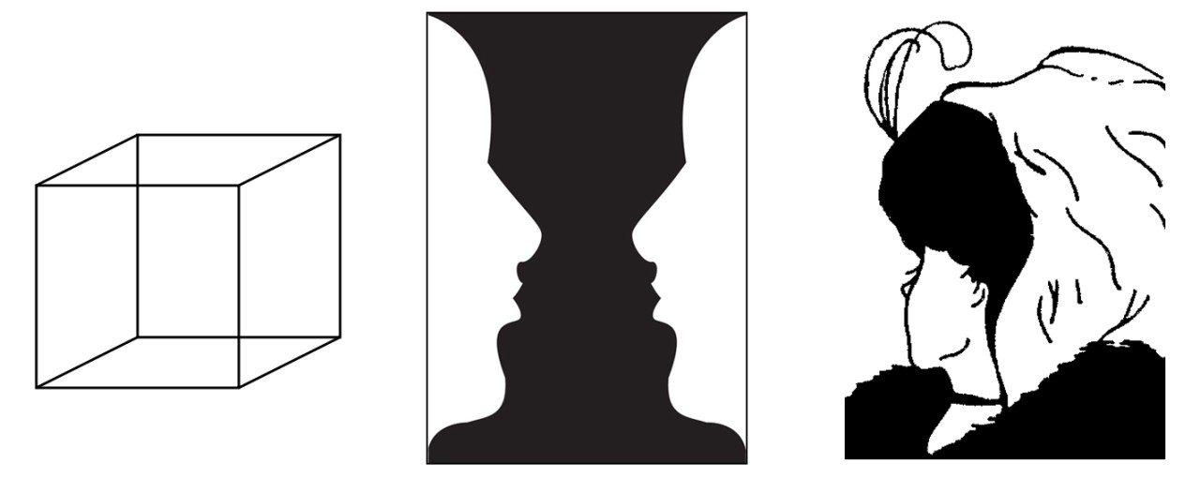
Alternative construals as either mass or multiplex
cf. Langacker (2008: 131), Johnson (1987: 26)
Non-plural Mass Noun
Plural Mass Noun
Cognitive multistability (Stadler & Kruse 1995),
similar to ambiguous figures
Notes:
LAJ

Slide 6
‘Many’ has a diverse array of expressions and etymological sources across the Slavic languages
 | mŭnogo ‘many’ (CSl) | velǐ- ‘great’ (CSl) | pǐlno ‘full’ (CSl) | bogato ‘rich’ (Old Persian) | daug ‘strong, useful’ (Lith/Goth) | *gōđa ‘good’ (Gmc) | ? (unclear origin)
Ukr |  |  |  | багато |  |  | шмат
Rus | много
Bel | многа |  |  | багата |  |  | шмат
Pol |  | wiele/wielu |  |  | dużo
Slk | mnoho | veľa
Ces | mnoho |  |  |  |  | hodně
Srp | много |  | пуно
Bul | много
Notes:
LAJ

Slide 7
Our data: 28 491 observations from the General Regionally Annotated Corpus of Ukrainian
Notes:
YP

Slide 8
Animacy and Word Order influence SG vs. PL
 | VS Word order |  |  |  | SV Word order
Verb number | Inanimate |  | Animate |  | Inanimate |  | Animate
Singular | 7,875 | 27.6% | 8,275 | 29.0% | 1,402 | 4.9% | 2,148 | 7.5%
Plural | 368 | 1.3% | 1,075 | 3.8% | 1,565 | 5.5% | 5,783 | 20.3%
Notes:
YP

Slide 9
Animacy and Word Order influence SG vs. PL
 | VS Word order |  |  |  | SV Word order
Verb number | Inanimate |  | Animate |  | Inanimate |  | Animate
Singular | 7,875 | 27.6% | 8,275 | 29.0% | 1,402 | 4.9% | 2,148 | 7.5%
Plural | 368 | 1.3% | 1,075 | 3.8% | 1,565 | 5.5% | 5,783 | 20.3%
Після СРСР нам залишилося багато речей, котрі нас і надалі тримають в спільному просторі...(Онлайн-ЗМІ «Zахід.net», 2009)
‘After the USSR, we were left with many things that will continue to keep us in a common space.’
Notes:
YP

Slide 10
Animacy and Word Order influence SG vs. PL
 | VS Word order |  |  |  | SV Word order
Verb number | Inanimate |  | Animate |  | Inanimate |  | Animate
Singular | 7,875 | 27.6% | 8,275 | 29.0% | 1,402 | 4.9% | 2,148 | 7.5%
Plural | 368 | 1.3% | 1,075 | 3.8% | 1,565 | 5.5% | 5,783 | 20.3%
це досить суттєві гроші і таким способом фінансувалися багато речей в країні, включаючи політичну корупцію. (Журнал «НВ», 2018)
‘this is a substantial amount of money and this is how many things in the country were financed, including political corruption’
Notes:
YP

Slide 11
Animacy and Word Order influence SG vs. PL
 | VS Word order |  |  |  | SV Word order
Verb number | Inanimate |  | Animate |  | Inanimate |  | Animate
Singular | 7,875 | 27.6% | 8,275 | 29.0% | 1,402 | 4.9% | 2,148 | 7.5%
Plural | 368 | 1.3% | 1,075 | 3.8% | 1,565 | 5.5% | 5,783 | 20.3%
Тоді прийшло багато людей, і гостям сподобалось. (Онлайн-ЗМІ «Маєш право знати - Бровари», 2014)
‘Many people came then, and the guests liked it.’
Notes:
Yp

Slide 12
Animacy and Word Order influence SG vs. PL
 | VS Word order |  |  |  | SV Word order
Verb number | Inanimate |  | Animate |  | Inanimate |  | Animate
Singular | 7,875 | 27.6% | 8,275 | 29.0% | 1,402 | 4.9% | 2,148 | 7.5%
Plural | 368 | 1.3% | 1,075 | 3.8% | 1,565 | 5.5% | 5,783 | 20.3%
На свято прийшли багато людей, всі навіть не помістилися у середині храму. (Інтернет-газета «Версії», 2017)
‘Many people came for the holiday, there wasn’t even room for all of them inside the church.’
Notes:
YP

Slide 13
Animacy and Word Order influence SG vs. PL
 | VS Word order |  |  |  | SV Word order
Verb number | Inanimate |  | Animate |  | Inanimate |  | Animate
Singular | 7,875 | 27.6% | 8,275 | 29.0% | 1,402 | 4.9% | 2,148 | 7.5%
Plural | 368 | 1.3% | 1,075 | 3.8% | 1,565 | 5.5% | 5,783 | 20.3%
Оскільки збиралися похапцем, багато речей залишилося вдома, до якого кримські татари обов'язково повернуться. (Онлайн-ЗМІ «Zахід.net», 2017)
‘Since they left in a hurry, many things got left at home, where the Crimean Tatars will definitely return.’
Notes:
YP
An inanimate noun in subject before verb word order can combine with a singular verb form.

Slide 14
Animacy and Word Order influence SG vs. PL
 | VS Word order |  |  |  | SV Word order
Verb number | Inanimate |  | Animate |  | Inanimate |  | Animate
Singular | 7,875 | 27.6% | 8,275 | 29.0% | 1,402 | 4.9% | 2,148 | 7.5%
Plural | 368 | 1.3% | 1,075 | 3.8% | 1,565 | 5.5% | 5,783 | 20.3%
Із уже згаданих причин багато речей залишилися на папері. (Інтернет-газета «Дзеркало тижня», 2020)
‘For the reasons previously mentioned, many things remained on paper.’
Notes:
YP

Slide 15
Animacy and Word Order influence SG vs. PL
 | VS Word order |  |  |  | SV Word order
Verb number | Inanimate |  | Animate |  | Inanimate |  | Animate
Singular | 7,875 | 27.6% | 8,275 | 29.0% | 1,402 | 4.9% | 2,148 | 7.5%
Plural | 368 | 1.3% | 1,075 | 3.8% | 1,565 | 5.5% | 5,783 | 20.3%
В акції брали участь лікарі, студенти, вчителі, багато людей прийшло з дітьми, – розповив Геннадій. (Світлана Талан «Оголений нерв», 2015)
‘Doctors, students, teachers participated in the demonstration, many people came with their children – said Hennadij.’
Notes:
YP
An animate noun combining with a singular verb form is less used in subject before verb word order

Slide 16
Animacy and Word Order influence SG vs. PL
 | VS Word order |  |  |  | SV Word order
Verb number | Inanimate |  | Animate |  | Inanimate |  | Animate
Singular | 7,875 | 27.6% | 8,275 | 29.0% | 1,402 | 4.9% | 2,148 | 7.5%
Plural | 368 | 1.3% | 1,075 | 3.8% | 1,565 | 5.5% | 5,783 | 20.3%
Акція проходила мирно, на Майдані був концерт, багато людей прийшли з дітьми. (Газета «Свобода», 2019)
‘The demonstration took place peacefully, there was a concert on the Majdan square, many people came with their children.’
Notes:
YP

Slide 17
Our analysis: Mixed-effects logistic regression in R
Notes:
LAJ

Slide 18
Prediction of Plural by fixed effects of mixed-effect logistic regression model
 | Estimate | Standard Error | z value | Pr (>|z|)
(Intercept) | -2.15067 | 0.07040 | -30.55 | < 2e-16 | ***
Year.sc | 0.93924 | 0.02988 | 31.44 | < 2e-16 | ***
Animacyanim | 0.62370 | 0.05320 | 11.72 | < 2e-16 | ***
Word_orderSV | 3.01155 | 0.04991 | 60.34 | < 2e-16 | ***
Intercept: Year.sc = 0.0 (= 2004), Animacy = inanimate, Word Order = VS
Notes:
LAJ

Slide 19
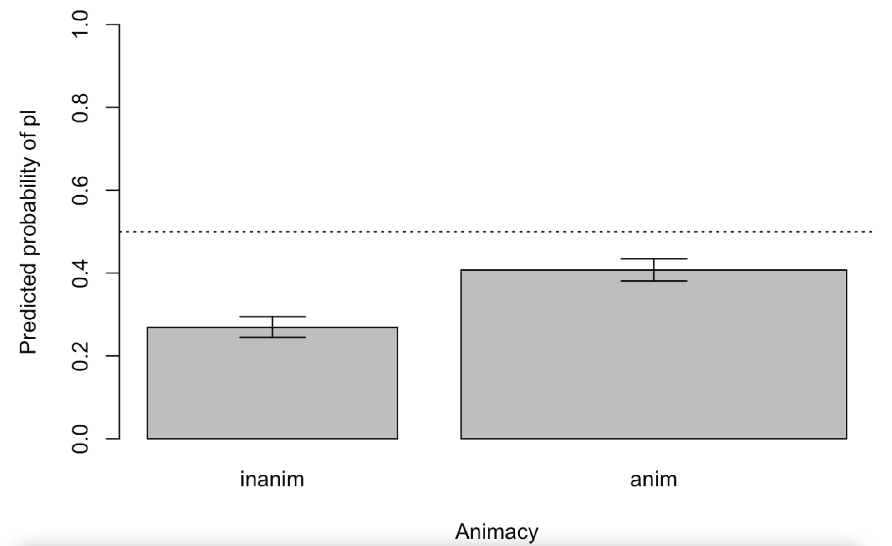
Predicted values for Animacy
Notes:
LAJ

Slide 20
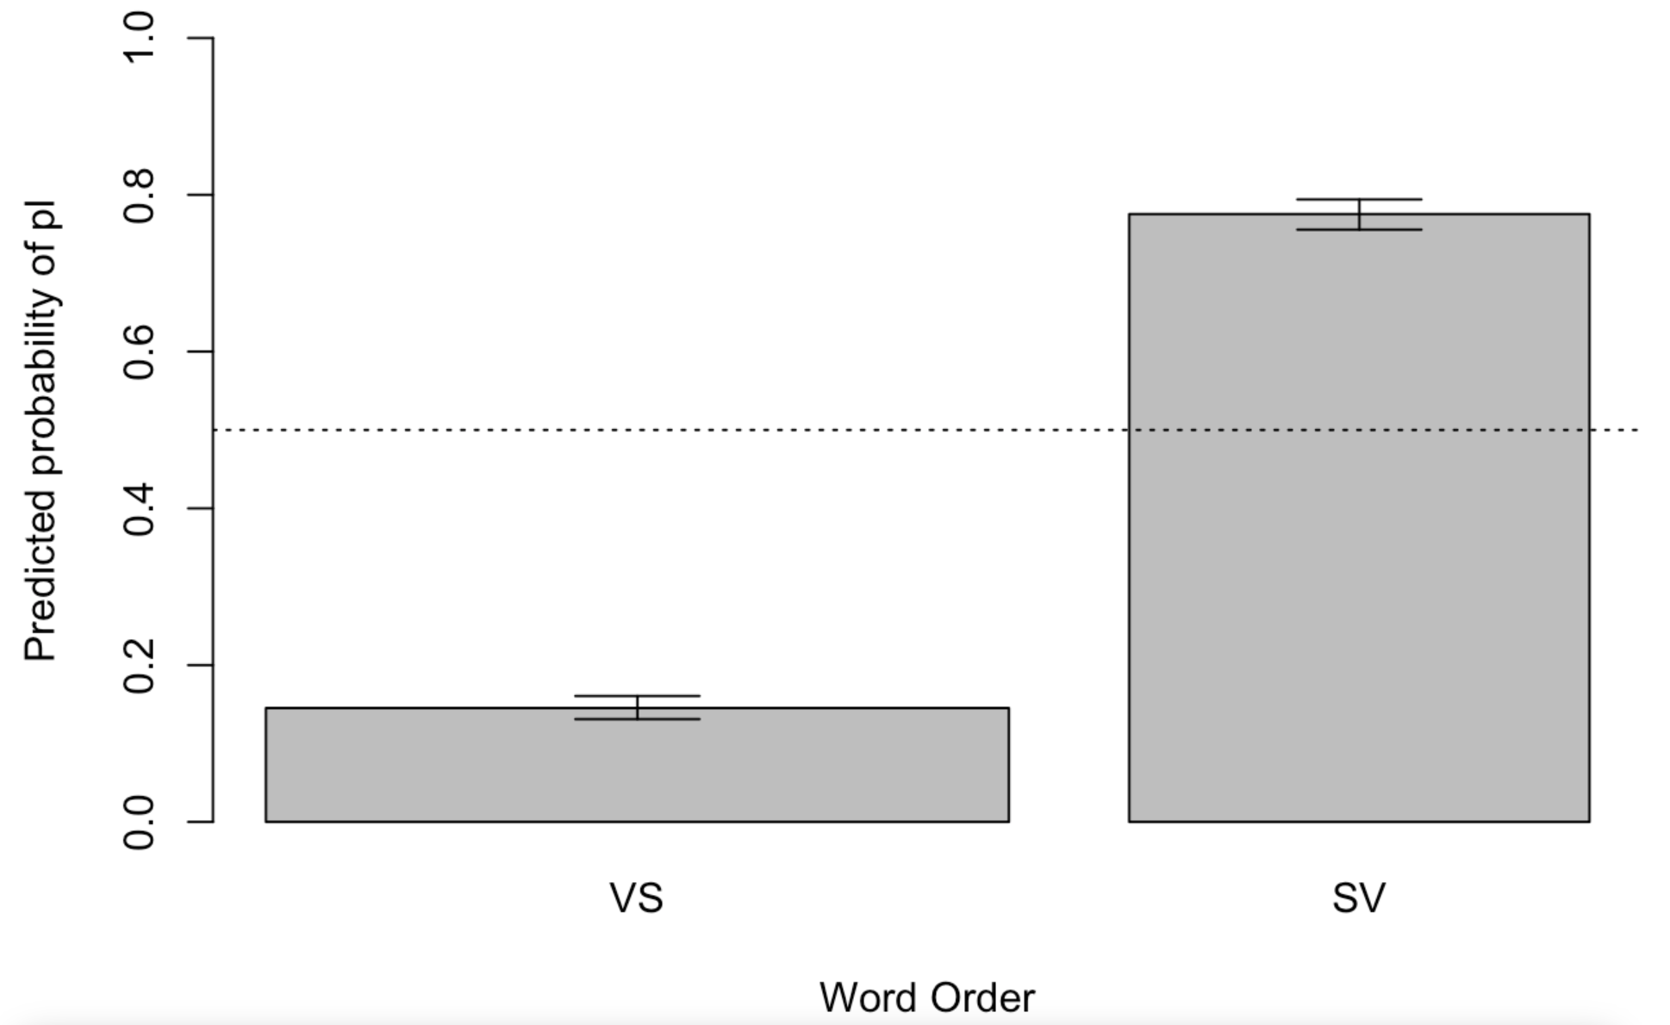
Predicted values for Word Order
Notes:
LAJ

Slide 21
Case studies: Verbs with strong preferences
Notes:
YP

Slide 22
Top 10 high-frequency verbs with strongest preference for Singular |  | Top 10 high-frequency verbs with strongest preference for Plural
минути ‘pass’ | 307 | розкритикувати ‘criticize’ | 21
відбутися ‘happen’ | 24 | засудити ‘condemn’ | 20
надійти ‘tun up’ | 204 | ввести ‘bring in, introduce’ | 21
виникнути ‘arise’ | 274 | заявити ‘declare’ | 43
виникати ‘arise’ | 102 | очікувати ‘expect’ | 26
накопичитися ‘accumulate’ | 140 | відзначати ‘mark, notice’ | 27
статися ‘happen’ | 107 | відчути ‘feel’ | 30
надходити ‘come’ | 84 | висловити ‘express’ | 50
полягти ‘perish’ | 44 | отримати ‘get’ | 129
назбиратися ‘gather, come together’ | 52 | пережити ‘experience’ | 23
Verb lemmas that appear in twenty or more examples and are ranked by the model at the extremes of a distribution from preference for Singular to preference for Plural. Shading indicates verbs with 100% of observations of only Singular or only Plural.
Notes:
YP

Slide 23
Case studies of verbs that strongly prefer SG: micro-constructions
PASSAGE OF TIME
HAPPEN
EXIST
ACCUMULATE
DIE
Together, the 28 verbs in these 5 semantic groups appear in 12,305 examples, constituting 43% of our total dataset
Notes:
YP

Slide 24
Group | Verb | N exx | % Sg | % VS | % inanim
passage of time | минути ‘pass’ | 307 | 100 % | 87 % | 100 %
 | пройти ‘pass’ | 203 | 78 % | 81 % | 68 %
І хоча минуло багато років, вона про цю подію розповідала з великим хвилюванням. (Інтернет-газета «Високий замок», 2003)
‘And although many years have passed, she talked about this event with great excitement.’
Common subjects: день ‘day’, місяць ‘month’, рік ‘year’
Notes:
YP

Slide 25
Group | Verb | N exx | % Sg | % VS | % inanim
happen | відбуватися ‘happen’ | 307 | 100 % | 87 % | 100 %
 | відбутися ‘happen’ | 24 | 100 % | 4 % | 100 %
 | виникнути ‘arise’ | 274 | 99 % | 89 % | 100 %
 | виникати ‘arise’ | 102 | 99 % | 81 % | 98 %
 | статися ‘happen’ | 107 | 99 % | 78 % | 99 %
Відтоді багато змін відбулося в житті актриси і мами. (Інтернет-газета «Дзеркало тижня», 2017)
‘Since then, many changes have taken place in the life of the actress and mother.’
Принаймні в автора цих рядків до режисера виникло багато запитань. (Інтернет-газета «Україна молода», 2012)
‘The author of these lines at least had many questions for the director.’ [literally: there arose many questions]
Notes:
YP

Slide 26
Group | Verb | N exx | % Sg | % VS | % inanim
exist | точитися ‘exist’ | 46 | 100 % | 91 % | 100 %
 | існувати ‘exist’ | 62 | 100 % | 95 % | 94 %
 | лежати ‘exist’ | 53 | 98 % | 81 % | 62 %
 | бути ‘be’ | 8257 | 93 % | 83 % | 54 %
 | знайтися ‘exist’ | 57 | 100 % | 95 % | 19 %
Потім точилося багато розмов про матеріальну підтримку своєї збірної від вірменської діаспори. (Інтернет-газета «Високий замок», 2003)
‘Then there were many conversations about the material support of the national team from the Armenian diaspora.’
У відділенні лежало багато хворих (Онлайн-ЗМІ «UNIAN.NET», 2020)
‘There were many patients in the ward’
when people are referred to, they have limited or subjugated agency
Notes:
YP

Slide 27
Group | Verb | N exx | % Sg | % VS | % inanim
accumulate | нагромадитися ‘accumulate’ | 23 | 100 % | 83 % | 100 %
 | накопичитися ‘accumulate’ | 140 | 99 % | 89 % | 100 %
 | надійти ‘show up’ | 204 | 100 % | 90 % | 97 %
 | надходити ‘show up’ | 84 | 100 % | 89 % | 96 %
 | назбиратися ‘gather’ | 52 | 100 % | 83 % | 94 %
 | постати ‘appear’ | 34 | 97 % | 74 % | 97 %
 | з’явитися ‘appear’ | 658 | 98 % | 97 % | 54 %
 | наїхати ‘arrive’ | 33 | 100 % | 85 % | 12 %
 | розвестися ‘accumulate’ | 40 | 100 % | 85 % | 10 %
 | зібратися ‘gather’ | 467 | 95 % | 91 % | 6 %
 | збиратися ‘gather’ | 66 | 97 % | 83 % | 3 %
Відвідувачі Гідропарку скаржаться, що там розвелося багато щурів. (Онлайн-ЗМІ «UNIAN.NET», 2013)
‘Visitors to the Hydropark complain that there are a lot of rats.’
Notes:
YP

Slide 28
Group | Verb | N exx | % Sg | % VS | % inanim
die | вимерти ‘die out’ | 16 | 94 % | 31 % | 12 %
 | загинути ‘die’ | 521 | 82 % | 65 % | 4 %
 | гинути ‘die’ | 28 | 82 % | 54 % | 7 %
 | померти ‘die’ | 96 | 77 % | 28 % | 3 %
 | полягти ‘perish’ | 44 | 95 % | 50 % | 0 %
І багато хлопців загинуло на моїх очах. (Сергій Сущенко, «Спогади», 2018)
‘And many boys died before my eyes.’
Notes:
YP

Slide 29
Summary of micro-constructions
Verbs associated with five micro-constructions that strongly prefer Singular forms account for 43% of the data in our study
Most verbs in these micro-constructions prefer VS Word order
Two micro-constructions are quite distinct: PASSAGE OF TIME, with nouns referring to durations, and DIE, dominated by human beings
The remaining three micro-constructions are related to each other
EXIST and ACCUMULATE: inanimate nouns refer primarily to communications and problems, while animates are usually people who are identified in relation to a given individual, idea, or event
Notes:
YP

Slide 30
Summing up: What we left out and conclusions
Notes:
Both

Slide 31
Things that we did not take into consideration
Distance between the Subject and Verb
Voice of Verb as Active vs. Passive
Aspect of Verb as Perfective vs. Imperfective
Individual author preferences
Dialectal or regional differences, influence from Russian, Polish
Other quantifiers
“Bare” багато without a Noun Phrase (meaning ‘many people’)
багато з них, багато з нас, багато з вас
Further semantic classification of nouns and verbs
Notes:
Both

Slide 32
Conclusions
In the bahato construction the relative frequency in our data is 69.1% Singular vs. 30.9% Plural.
This relative frequency has changed over time: Plural has increased and recently overtaken Singular.
SV word order and animate nouns prefer Plural.
Individual verbs have their own preferences for verb number.
A handful of micro-constructions that prefer Singular play a large role.
Notes:
Both

